Slide 1
UNIVERSITATEA DIN BUCUREŞTI FACULTATEA DE MATEMATICĂ ȘI INFORMATICĂ, SPECIALIZAREA INGINERIE SOFTWARE
Semestrial Project
Design parking lot
Student,
Ceachi Bogdan
București
2019

Slide 2
Project #1
Design a parking lot on the following assumptions:
1. The parking lot has multiple levels
2. In the parking lot you can park motorcycles, cars, and buses
3. The parking lot has small spots, compact spots, and large spots
4. A motorcycle can park in any spot
5. A car can park in either a single compact spot or a single large spot
6. A bus can park in five large spots that are consecutive and within the
same row

Slide 3
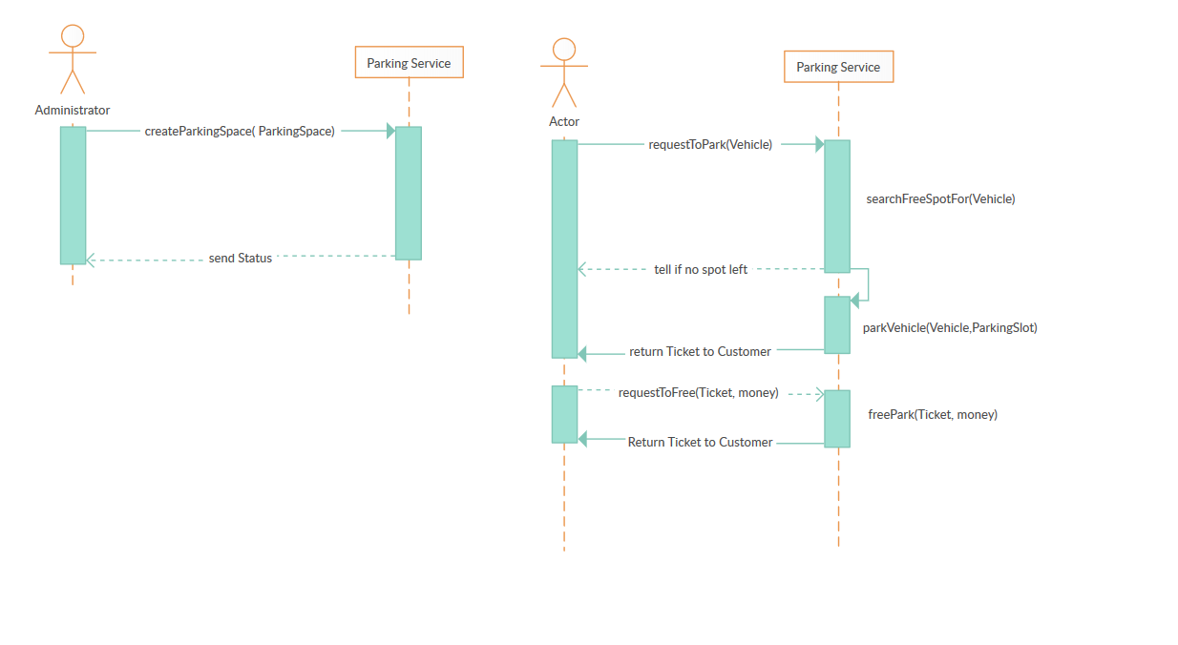
Sequence diagram

Slide 4
Design Patterns & Principles
Creational Patterns
- Singleton
Builder
Structure Patterns
Façade
SOLID
DRY
KISS

Slide 5
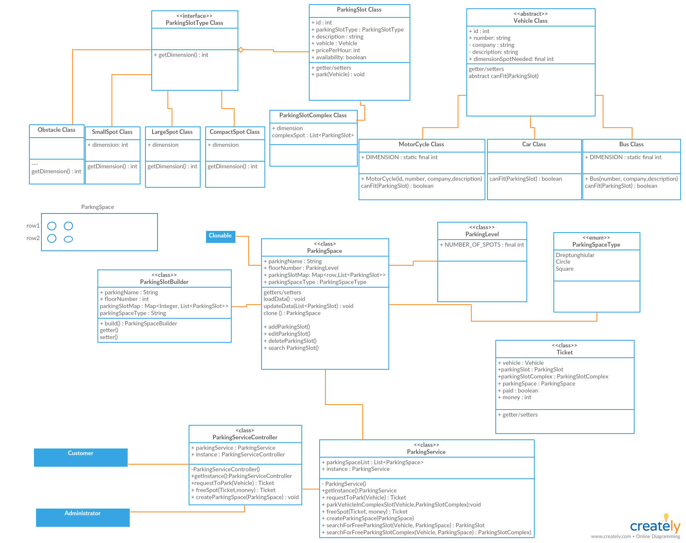
UML Diagram

Slide 6
Technologies used
Programming Language : Java
Framework: Spring Boot

